Slide 2
Topics for Today
Need of PIG
Why PIG was created?
Why go for PIG when MapReduce is there?
Use Cases where Pig is used
Use Case in Healthcare
Where not to use PIG
Weather data with PIG
Let’s start with PIG
PIG Components
PIG Data Type
PIG vs Hive

Slide 3





Need Of Pig
Do you know Java?
10 lines of PIG = 200 lines of Java
+ Built in operations like:
Join
Group
Filter
Sort
and more…

Slide 4
Why Was Pig Created?
An ad-hoc way of creating and executing map-reduce jobs on very large data sets
Rapid Development
No Java is required
Developed by Yahoo!

Slide 5







Why Should I Go For Pig When There Is MR?
1/20 the lines of Code
1/16 the development Time
180
160
140
120
100
80
60
40
20
0
300
250
200
150
100
50
0
Minutes
Hadoop
Pig
Hadoop
Pig
Performance On Par With Raw Hadoop

Slide 6


Why Should I Go For Pig When There Is MR?
MapReduce
Powerful model for parallelism.
Based on a rigid procedural structure.
Provides a good opportunity to parallelize algorithm.
Have a higher level declarative language.
PIG
It is desirable to have a higher level declarative language.
Similar to SQL query where the user specifies the “what” and leaves the “how” to the underlying processing engine.

Slide 7







Where Should I use Pig?
Pig
Pig is a data flow language.
It is at the top of Hadoop and makes it possible to create complex jobs to process large volumes of data quickly and efficiently.
Case 1 – Time Sensitive Data Loads
Case 2 – Processing Many Data Sources Case 3 – Analytic Insight Through Sampling
Hadoop

Slide 8

Where not to use Pig?
Really nasty data formats or completely unstructured data
(video, audio, raw human-readable text).
Pig is definitely slow compared to Map Reduce jobs.
When you would like more power to optimize your code.

Slide 9




Annie’s Question
Apache Pig is a platform for analysing?
Small Data
Data less than 10 GB
Large Data
All of them
Hello There!!
My name Annie.
I love quizzes and puz and am he e make you guys think and
answer my questions.

Slide 10



Annie’s Answer
Large Data.

Slide 11
What is Pig?
Pig is an open-source high-level dataflow system.
It provides a simple language for queries and data manipulation Pig Latin, that is compiled into map-reduce jobs that are run on Hadoop.
Why Is It Important?
Companies like Yahoo, Google and Microsoft are collecting enormous data sets in the form of click streams, search logs, and web crawls.
Some form of ad-hoc processing and analysis of all of this information is required.

Slide 12
Use Cases Where Pig Is Used…
Processing of Web Logs
Data processing for search platforms
Support for Ad Hoc queries across large datasets.
Quick Prototyping of algorithms for processing large datasets.

Slide 13
Examples Of Data Analysis Task
Find users who tend to visit “good” pages:
VISITS
PAGES
User | URL | Time
Amy | www.cnn.com | 8:00
Amy | www.crap.com | 8:05
Amy | www.myblog.com | 10:00
Amy | www.flickr.com | 10:05
Fred | cnn.com/index.htm | 12:00
URL | Page Rank
www.cnn.com | 0.9
www.flickr.com | 0.9
www.myblog.com | 0.7
www.crap.com | 0.2

Slide 14



















Conceptual Data Flow
Load
Visits (user, url, time)
Load
Pages (url, pagerank)
Join url = url
Group by user
Compute Average Pagerank
Filter
avgPR>0.5

Slide 15
How Yahoo Uses Pig?
Pig is best suited for the data factory.
Data Factory contains: Pipelines:
Pipelines bring logs from Yahoo!'s web servers.
These logs undergo a cleaning step where bots, company internal views, and clicks are removed.
Research:
Researchers want to quickly write a script to test a theory.
Pig integration with streaming makes it easy for researchers to take a Perl or Python script and run it against a huge data set.

Slide 16
Use Case In HealthCare
Problem Statement:
De-identify personal health information.
Challenges:
Huge amount of data flows into the systems daily and there are multiple data sources that we need to aggregate data from.
Crunching this huge data and deidentifying it in a traditional way had problems.

Slide 17

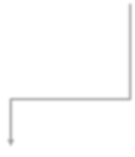









Use Case In HealthCare
0100
1101
1001
Taking DB dump in CSV format and ingest into HDFS
Store Deidentified CSV file into HDFS
0100
1101
1001
HDFS
Read CSV file from HDFS
Pig Script
Deidentify columns based on configurations and store the data back in a CSV file

Slide 18
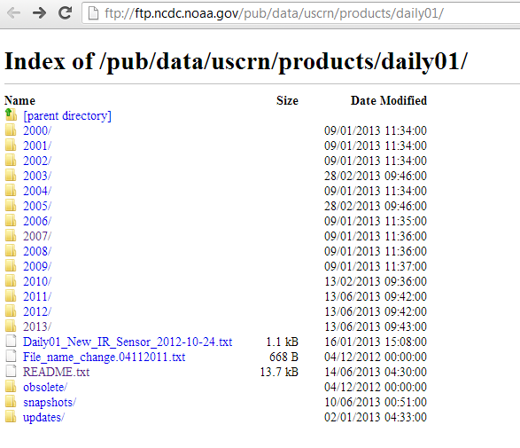
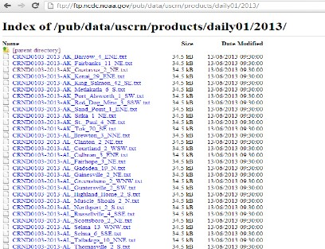
Weather Data With Pig
ftp://ftp.ncdc.noaa.gov/pub/data/uscrn/products/daily01/

Slide 19









Pig - Basic Program Structure
Script:
Pig can run a script file that contains Pig commands.
Example: pig script.pig runs the commands in the local file script.pig.
Grunt:
Grunt is an interactive shell for running Pig commands. It is also possible to run Pig scripts from within Grunt using run and exec (execute).
Embedded:
Embedded can run Pig programs from Java, much like you
can use JDBC to run SQL programs from Java.
Script
Grunt
Embedded

Slide 20

















Pig Is made Up Of Two Components
Pig Latin is used to express Data Flows
1.
Pig
Data Flows
_{2.} Execution Environments
Distributed execution on a Hadoop Cluster
Local execution in a
single JVM

Slide 21



Pig Execution
Pig resides on user machine
Job executes on Cluster
Hadoop
Cluster
User Machine
No need to install anything extra on your Hadoop Cluster!

Slide 22









Pig Latin Program
Pig Latin Program
It is made up of a series of operations or transformations that are applied to the input data to produce output.
Pig
Turns the transformations into…
A series of MapReduce jobs

Slide 23












Four Basic Types Of Data Models
Atom
Tuple
Data Model Types
Bag
Map

Slide 24
Data Model
Data Models can be defined as follows:
A bag is a collection of tuples.
A tuple is an ordered set of fields.
A field is a piece of data.
A Data Map is a map from keys that are string literals to values that can be
any data type.
Example:
t = < 1, {<2,3>,<4,6>,<5,7>}, ['apache':'search']>

Slide 25
Pig Data Types
Pig Data Type | Implementing Class
Bag | org.apache.pig.data.DataBag
Tuple | org.apache.pig.data.Tuple
Map | java.util.Map<Object, Object>
Integer | java.lang.Integer
Long | java.lang.Long
Float | java.lang.Float
Double | java.lang.Double
Chararray | java.lang.String
Bytearray | byte[]

Slide 26
Pig Latin Relational Operators
Category | Operator | Description
Loading and Storing | LOAD STORE DUMP | Loads data from the file system or other storage into a relation . Saves a relation to the file system or other storage. Prints a relation to the console.
Filtering | FILTER DISTINCT FOREACH...GENERATE STREAM | Removes unwanted rows from a relation. Removes duplicate rows from a relation. Adds or removes fields from a relation. Transforms a relation using an external program.
Grouping and Joining | JOIN COGROUP GROUP CROSS | Joins two or more relations. Groups the data in two or more relations. Groups the data in a single relation. Creates the cross product of two or more relations.
Sorting | ORDER LIMIT | Sorts a relation by one or more fields. Limits the size of a relation to a maximum number of tuples.
Combining and Splitting | UNION SPLIT | Combines two or more relations into one. Splits a relation into two or more relations.

Slide 27






Pig Latin - Nulls
In Pig, when a data element is NULL, it means the value is unknown.
Includes the concept of a data element being…
Pig
NULL
Data of any type can be NULL.

Slide 28
Data
File – Student
File – Student Roll
Name | Age | GPA
Joe | 18 | 2.5
Sam |  | 3.0
Angel | 21 | 7.9
John | 17 | 9.0
Joe | 19 | 2.9
Name | Roll No.
Joe | 45
Sam | 24
Angel | 1
John | 12
Joe | 19

Slide 29
Pig Latin – Group Operator
Example of GROUP Operator:
A = load 'student' as (name:chararray, age:int, gpa:float); dump A; (joe,18,2.5)
(sam,,3.0)
(angel,21,7.9)
(john,17,9.0)
(joe,19,2.9)
X = group A by name; dump X;
(joe,{(joe,18,2.5),(joe,19,2.9)})
(sam,{(sam,,3.0)})
(john,{(john,17,9.0)})
(angel,{(angel,21,7.9)})

Slide 30
Pig Latin – COGroup Operator
Example of COGROUP Operator:
A = load 'student' as (name:chararray, age:int,gpa:float); B = load 'studentRoll' as (name:chararray, rollno:int);
X = cogroup A by name, B by name; dump X;
(joe,{(joe,18,2.5),(joe,19,2.9)},{(joe,45),(joe,19)})
(sam,{(sam,,3.0)},{(sam,24)})
(john,{(john,17,9.0)},{(john,12)})
(angel,{(angel,21,7.9)},{(angel,1)})

Slide 31
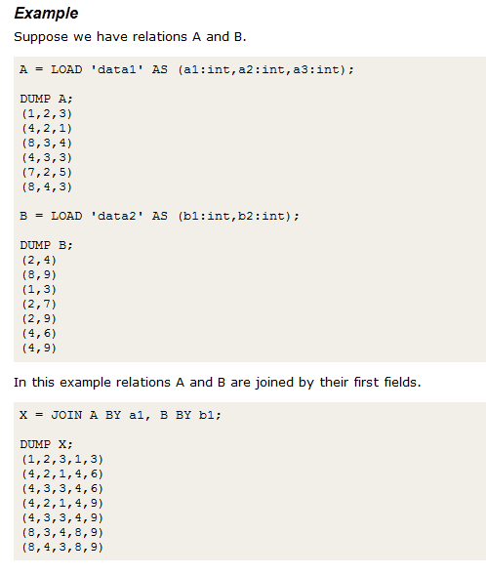
Joins And COGROUP
de 33
JOIN and COGROUP operators perform similar functions.
JOIN creates a flat set of output records while
COGROUP creates a nested set of output records.
Sli

Slide 32
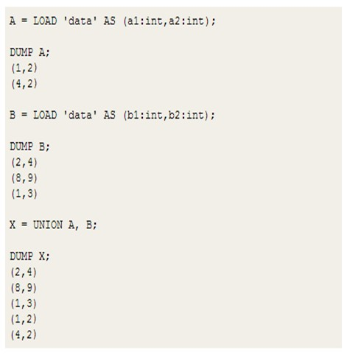
Union
UNION: To merge the contents of two or more relations.

Slide 33
Further Reading
Review the following Blogs on Pig Scripts:
http://www.edureka.in/blog/operators-in-apache-pig/ http://www.edureka.in/blog/diagnostic-operators-apachepig/

Slide 34






Diagnostic Operators & UDF Statements
Pig Latin Diagnostic Operators
Types of Pig Latin Diagnostic Operators:
DESCRIBE - Prints a relation’s schema. EXPLAIN - Prints the logical and physical plans. ILLUSTRATE - Shows a sample execution of the
logical plan, using a generated subset of the input.
Pig Latin UDF Statements
Types of Pig Latin UDF Statements:
REGISTER - Registers a JAR file with the Pig runtime.
DEFINE - Creates an alias for a UDF, streaming script, or a command specification.

Slide 35
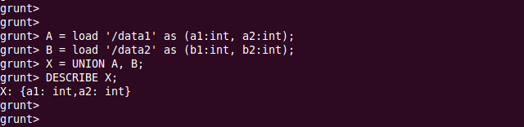
Describe
Use the DESCRIBE operator to review the fields and data-types.

Slide 36
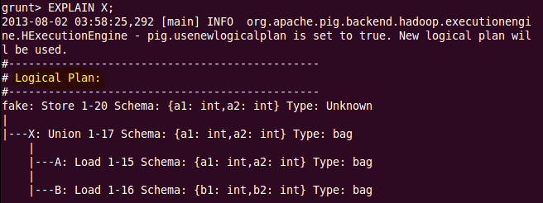
EXPLAIN : Logical Plan
Use the EXPLAIN operator to review the logical, physical, and map reduce execution plans that are used to compute the specified relationship.
The logical plan shows a pipeline of operators to be executed to build the relation. Type checking and backend-independent optimizations (such as applying filters early on) also apply.

Slide 37
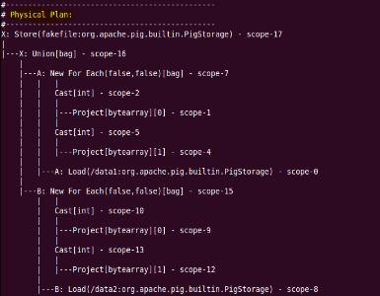
EXPLAIN : Physical Plan
The physical plan shows how the logical operators are translated to backend-specific physical operators. Some backend optimizations also apply.

Slide 38
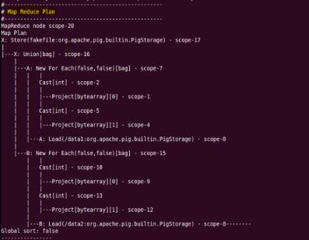
EXPLAIN : MapReduce Plan
The mapreduce plan shows how the physical operators are grouped into map reduce jobs.

Slide 39
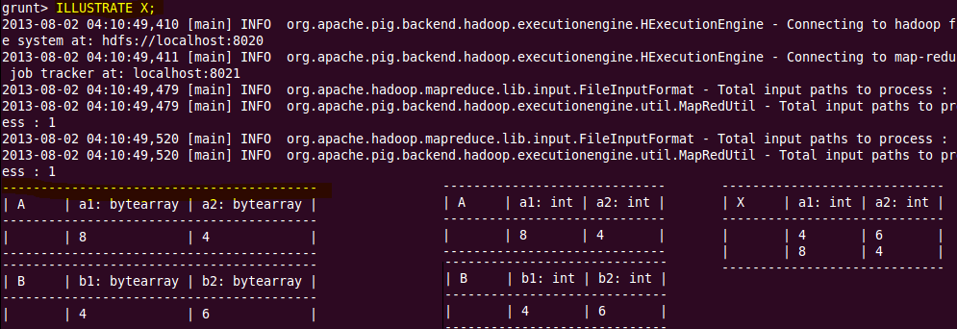
Illustrate
ILLUSTRATE command is used to demonstrate a "good" example input data.
Judged by three measurements:
1 – Completeness 2 – Conciseness
3 – Degree of realism

Slide 40



Pig Latin – File Loaders
Pig Latin File Loaders
BinStorage
- "binary" storage
PigStorage
- loads and stores data that is delimited by something
TextLoader
- loads data line by line (delimited by the newline character)
CSVLoader - Loads CSV files
XML Loader - Loads XML files

Slide 41
Pig Latin – Creating UDF
A Program to create UDF:
public class IsOfAge extends FilterFunc {
@Override
public Boolean exec(Tuple tuple) throws IOException { if (tuple == null || tuple.size() == 0) { return false;
}
try {
Object object = tuple.get(0);
if (object == null) { return false;
}
int i = (Integer) object;
if (i == 18 || i == 19 || i == 21 || i == 23 || i == 27) { return true;
} else {
return false;
}
} catch (ExecException e) { throw new IOException(e);
}
}
}

Slide 42
Pig Latin – Calling A UDF
How to call a UDF?
register myudf.jar;
X = filter A by IsOfAge(age);

